Slide 1



Professor : Susanna Hayrapetyan Course : MADSC305-Online Reputation Management Date: 19-05-2023
Kumar Gaurav – 22026398

Slide 2
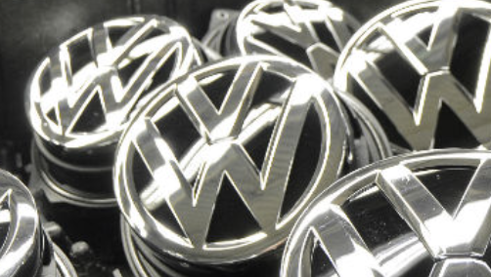
Table Of Content
Volkswagen Denounced of?
”Defeat device" sounds like a high-tech gadget.
What has been VW’s response?
After the incident.
The impact of the event.
Will more heads roll?
Will more people be held accountable?
Are other carmakers involved?
Emission Test
EU testing regulations should be stricter
Another set back for the diesel industry.
References

Slide 3
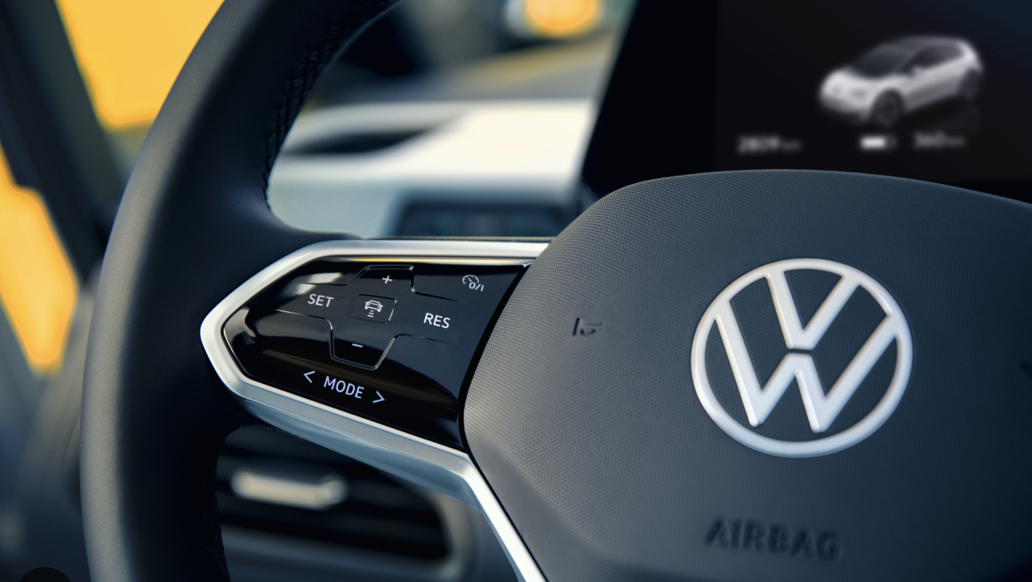
Volkswagen Emission Scandal

Slide 4


Volkswagen Denounced of?
In September,2015 the Environmental Protection Agency (EPA) discovered that many VW cars sold in America had "defeat devices"—or software—in diesel engines that could recognize when they were being tested and adjust their performance to produce better results.
The company was also accused by the EPA of modifying the software on the 3-liter diesel engines installed in some Porsche, Audi and VW models. VW has denied the claims involving at least 10,000 vehicles.

Slide 5

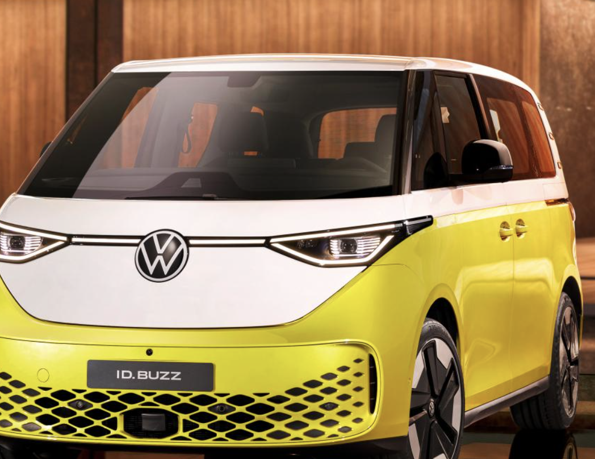
According to VW, the so-called "defeat device" is installed in about 11 million cars worldwide, including 8 million in Europe.
Around 800,000 cars in Europe, including petrol vehicles, may be affected by "irregularities" discovered by VW in tests to measure carbon dioxide emissions levels, the automaker said in November, 2015.

Slide 6
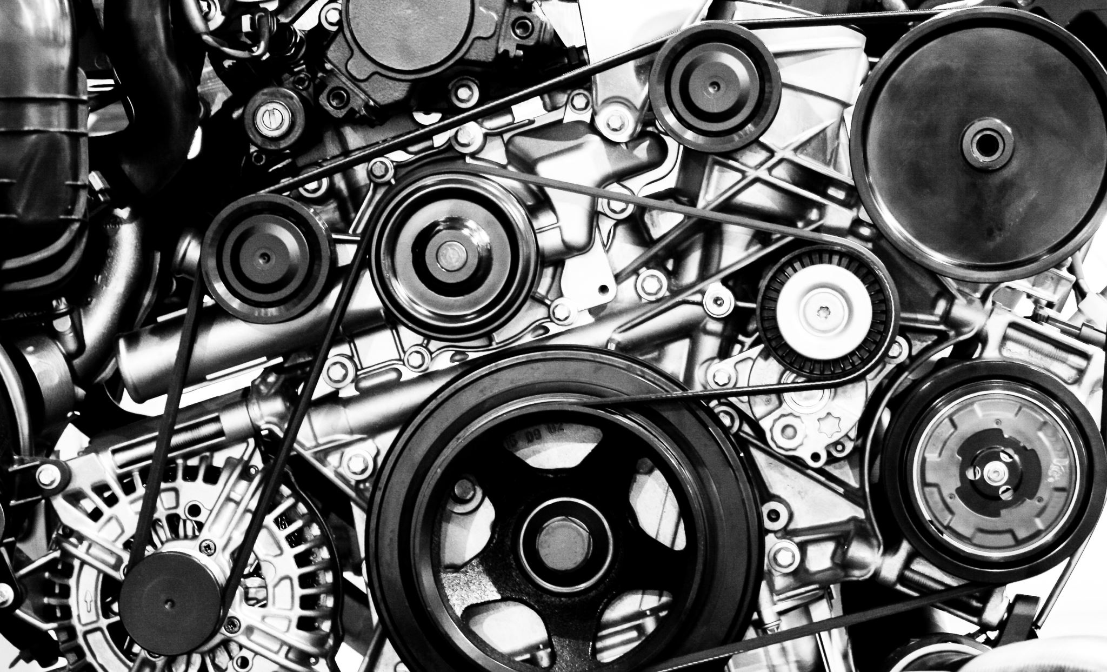
”Defeat device" sounds like a high-tech gadget.
The device seems to have put the vehicles into a kind of safety mode where the engine ran below normal power and performance when they were operating under controlled laboratory conditions, which usually involve putting them on a stationary test rig.
The engines changed from this test mode when they were on the road.
The engines as a result released nitrogen oxide pollutants up to 40 times more than what the US allows.

Slide 7
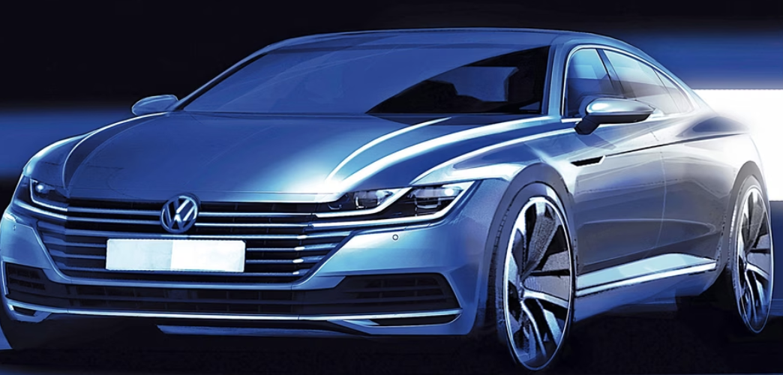
What has been VW’s response?
There have been questions about the discrepancy between the public emissions test results and the actual emissions, but the public has no reasonable explanation for this.
Public management seems to have been convinced that if things went south, they could simply pay a fine and be done with it.
They have failed to provide accurate, timely, comprehensive and True report, record and statements
They conceal facts from consumers and the government and retain information from investors in violation of the securities laws.

Slide 8

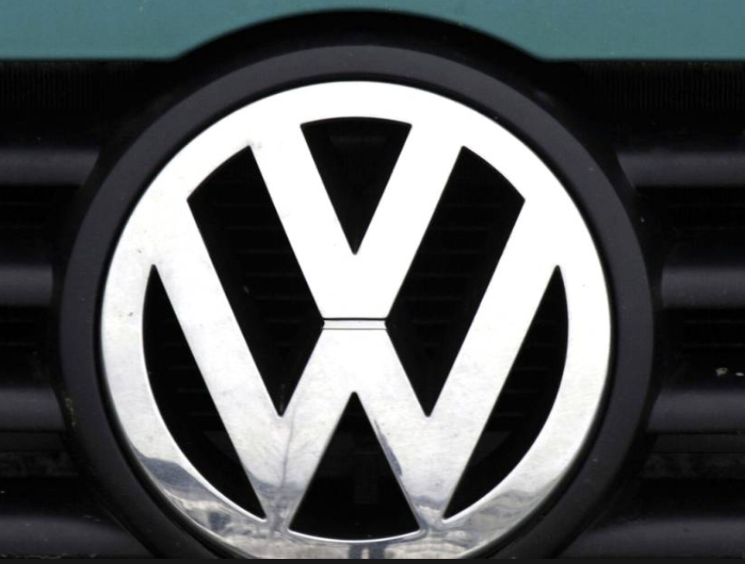
Once the news came out, CEO of Volkswagen Winterkorn first apologized and was forced to resign the next day.
At the same time, the stock price plummeted, and Volkswagen brought a huge crisis and faced a huge fine from the United States.
“We‘ve totally screwed up” ( Horn, 2015)
“broken the trust of our customers and the public”. ( Winterkorn, 2015)
“My most urgent task is to win back trust for the Volkswagen Group - by leaving no stone unturned” (Mueller, 2015)

Slide 9

After the incident.
VW has been charged and fined.
Other brands with diesel cars were also found to have violated the rules after a wave of inspections, Fiat Chrysler Automobiles, Nissan, Renault, Mercedes-Benz, etc. all failed the inspection.
Volkswagen reached a $1 billion settlement with U.S. regulators to buy back about 20,000 of the vehicles in question, repair the remaining 60,000, and pay $225 million to an environmental trust to eliminate the effects of excessive emissions from the company's products.
Authorities have also thoroughly investigated diesel vehicles from other brands in the group, such as Porsche and Audi

Slide 10
The impact of the event.
Investors: Stock plunge
Consumers: Creditworthiness, transparency of products, honest marketing.
Future strategy: In 2019, Fuchs plans to launch an electric vehicle.

Slide 11
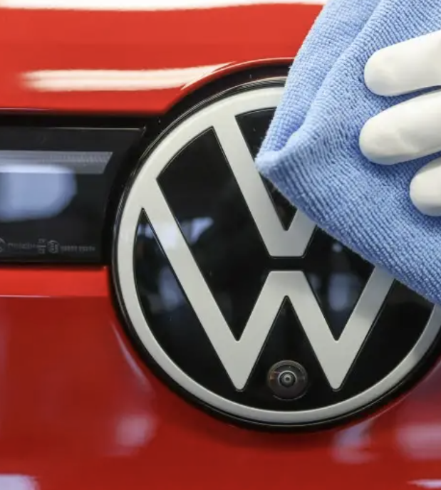

Will more heads roll?
Has spread to more and more countries
Governments, regulators and environmental groups are questioning the legitimacy of Volkswagen's emissions tests.
Volkswagen is recalling 8.5 million vehicles in Europe, including 2.4 million in Germany, 1.2 million in the United Kingdom and 500,000 in the United States.
The affected vehicles are about 18,798, including Audi, Volkswagen, Volkswagen CV and SKODA brands

Slide 12
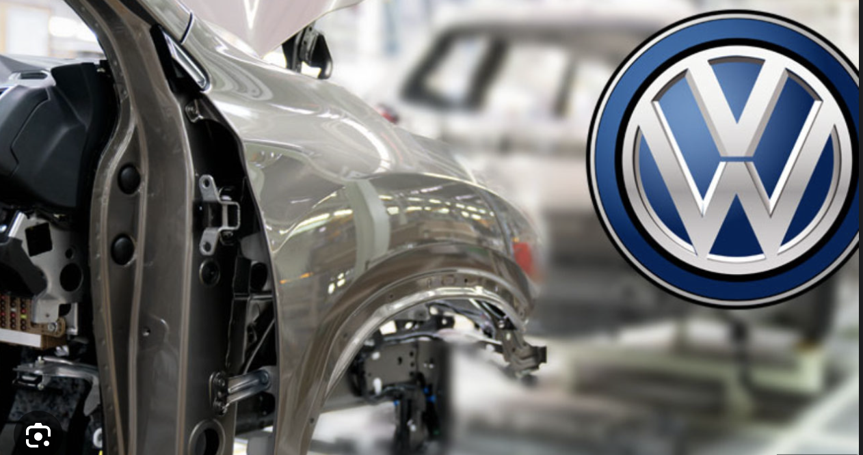
Will more people be held accountable?
Uncovering the VW Emissions Scandal: Key Points and Departures:
VW's chain of command likely allowed the installation of cheating devices in its engines, indicating clear knowledge of the issue.
Christian Klingler, a member of the management board and the head of sales and marketing, has quit the firm, but VW insists this is due to long-term structural changes and is unrelated to current event
Concerns about VW's pollution levels were raised by US regulators in 2014, but the firm dismissed them as "technical issues" and blamed "unexpected" real-world conditions.
It seems unlikely that executives and managers will be allowed to keep their jobs if they willfully mislead officials or their VW superiors.

Slide 13
Are other carmakers involved?
Following the Volkswagen emissions crisis, California's Air Resources Board is looking into the testing results of other manufacturers.
Ford, BMW, and Renault-Nissan have all declared that "defeat devices" were not used in their vehicles.
Some businesses have chosen not to comment on the matter, while others have simply stated that they are in conformity with the law.

Slide 14

Emission Test
The SMMT, the UK's vehicle industry trade organization, pointed out that the EU has a distinct testing system than the US, with tests undertaken under tight conditions mandated by EU legislation and regulated by an independent approval agency.
The industry recognizes the need for an updated emissions test technique that combines new technology and more accurately reflects real-world driving situations and is seeking European Commission certification for such a test.

Slide 15
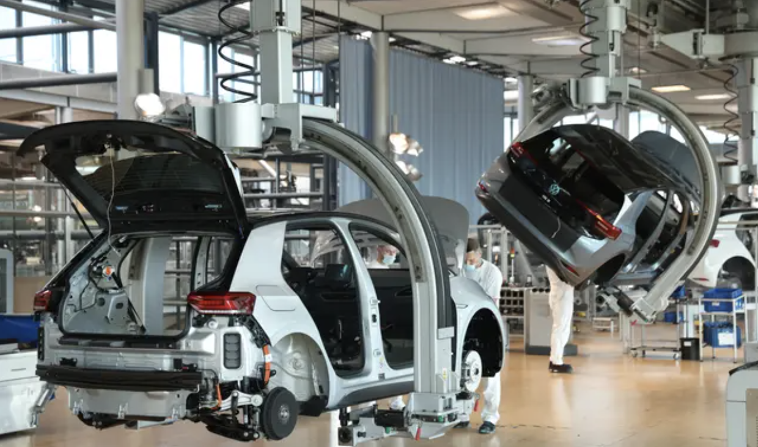
EU testing regulations should be stricter
Regulations governing emissions have been disregarded.
On average, European diesel cars have less advanced technology than American ones.
Almost 90% of diesel vehicles didn’t meet emission limits when they are driven on the road.

Slide 16

Another set back for the diesel industry.
The VW scandal came at a bad time. The revelations are likely to lead to a sharp fall in demand for diesel engine cars.
The Diesel car market in US currently represents around 1% of all new car sales and is unlikely to increase.
The impact, though, could be far worse in Europe and cause a big portion of the market to migrate to automobiles with gasoline engines.

Slide 17
References
Horn, M. (2015) Volkswagen: The scandal explained. Available at: https://www.bbc.com/news/business-34324772 (Accesed: 18 May, 2023)
Winterkorn, M. (2015) Volkswagen: The scandal explained. Available at: https://www.bbc.com/news/business-34324772 (Accesed: 18 May, 2023)
Mueller, M.(2015) Volkswagen: The scandal explained. Available at: https://www.bbc.com/news/business-34324772 (Accesed: 18 May, 2023)

Slide 18


